Slide 1
My UX
Turkka Keinonen
9.2.2010 NRC Helsinki

Slide 2
Core, forgotten and alternative views
Workload >
usability >
Value of time >
Affect >
Satisfaction >
Ethics >
Social amplification of experience >
Mood boarding >

Slide 3
Workload
“the perceived relationship between the amount of mental processing capability or resources and the amount required by the task” (Hart and Staveland 1987)
Multidimensional influenced by internal and external factors
Subjective and objective
immediate and long term
Highly contextual
Negative by nature, i.e. usually less is better, though absence harmful
Workload = engagement (Laurel 1991: frequency, impact, versatility)
UX seen as ‘positive workload’

Slide 4
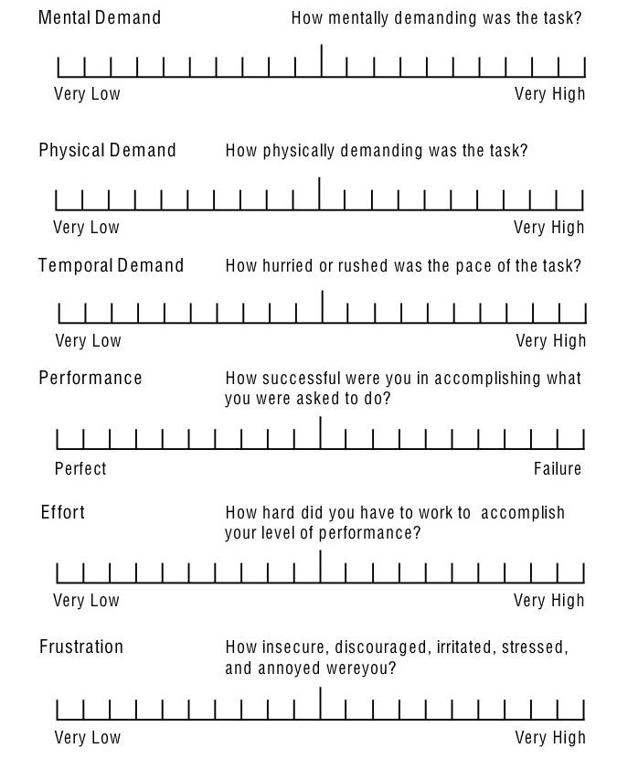
NASA TLX
NASA Task Load Index
(Hart & Staveland 1988)
Step 1: weights
  Pair comparison of the scales gives them weights from 0 to 5
  Allows adjusting to specific task demands
Step 2: assesment
  Evaluate task load on 6 Likert scales
www.nrl.navy.mil/aic/ide/NASATLX.php
Generic scales
Adjustable weights

Slide 5
NASA TLX
MENTAL DEMAND
How much mental and perceptual activity was required (e.g., thinking, deciding, calculating, remembering, looking, searching, etc.)? Was the task easy or demanding, simple or complex, exacting or forgiving?
PHYSICAL DEMAND
How much physical activity was required (e.g., pushing, pulling, turning, controlling, activating, etc.)? Was the task easy or demanding, slow or brisk, slack or strenuous, restful or laborious?
TEMPORAL DEMAND
How much time pressure did you feel due to the rate or pace at which the tasks or task elements occurred? Was the pace slow and leisurely or rapid and frantic?
EFFORT
How hard did you have to work (mentally and physically) to accomplish your level of performance?
PERFORMANCE
How successful do you think you were in accomplishing the goals of the task set by the experimenter (or yourself)? How satisfied were you with your performance in accomplishing these goals?
FRUSTRATION LEVEL
How insecure, discouraged, irritated,stressed and annoyed versus secure, gratified, content, relaxed and complacent did you feel during the task?
Compare, e.g. Jordan’s pleasures

Slide 6
Usability
‘quality of use in context’ (Bevan & Macleod)
Satisfaction as a dimension of usability
  Subjective approach to measure
  A measurement of used resources namely frustration
In UX there can be resource gains
  ‘anti-frustrations’
  Usability without efficiency OR
Usability = output / resource
UX = output x resource

Slide 7
Value of time
Value of time (in money) (e.g. Kilkki, Jalas)
  Interactions where the user is payed
  Interactions where the user pays
Minute prize as the unit of UX. Negative of positive.

Slide 8
Affect
Russel 1991 – seriously consider arousal, valence is obvious
arousal
valence

Slide 9
Satisfaction
Performance during interaction in context (Oliver 1993)
expectation
confirmation
satisfaction
Performance
Performance
Equity
Attribution

Slide 10
Ethics
Design ethical choices (Keinonen 2010)
Not only pleasure but respect
Augment (A+)
Excite
“We provide all the means the technology allows today. “
Nurture
“We guide the users to the kind material they choose.“
Confront (P-)
Protect (P+)
Exploit
“There are many bugs but we’ve to go to market for feedback.”
Cushion
“We stick to our easy to use proprietary architecture.”
Reduce (A-)

Slide 11
Social amplification of experience
Coexperience (Battarbee)
Case shared images
Friends comments on images afterwards make them and thus the experiences more salient and thus meaningful
Is UX with a gadget socially amplified?
Can social amplification be measured
Process:
Step 1: collection of experiences with an UI (device-person)
Step 2: rating the the experiences (experience-reference group)

Slide 12
Mood board
Andres Lucero PhD in TUDelft (NRC Tre precently)
Visual representation of the spirit and style of the product – part of design spec.
‘Interaction board’ as a tool for UX specification non-verbally

