Slide 1
UX Tools Workshop
23/03/2010

Slide 2
Agenda
Results from the previous workshop
Status of the project
Integrating UXP, UXM, UXX
Focusing UX – Conceptual framework
Discussions

Slide 3
Results from the previous workshop

Slide 4
Workshop Results
Grouping
Due to schedule issues the grouping of the post-its was incomplete
Focus on finding a general view of attitudes, opinions and interests
A total of 302 post-its

Slide 5
Workshop Results
Grouping
21 groups
  Attractiveness, Attachment, Stimulation, Annoyance, Fun, Social, Trends, Expectations
  Utility, Personalization, Usability, UX Production, Features, Measurement, Time
  Pricing, Marketing, Ethics
  Models, Routine
  Anti UX

Slide 6
Workshop Results
Findings
It’s important to measure not only the total UX of some product but the UX of individual features also
UX is more than just singular WOW
  UX is a longer-lasting phenomenon
  UX changes with time
  UX does not have to be very high on arousal
Good UX can replace poor usability/utility

Slide 7
Workshop Results
Findings
UX is on emotional level
UX for concepts/prototypes is hard because of technology/usability issues
> 40 post-its regarding measurement

Slide 8
Workshop Results
Findings
UX is hard to limit, especially to a product
  UX is connected to the expectations of the user
  UX is connected to the brand
  UX is connected to user’s motivations
”The part of UX that can be controlled by the designers is in the user interface”

Slide 9
Status of the project
Interviews
Literature
Project Plan

Slide 10
Status of the project
Interviews
Literature
Project Plan

Slide 11
Interviews
Services
Markets
Solutions
Devices
*Interviewees position within (simplified) Nokia structure

Slide 12
Interviews
Reporting on Interviews?

Slide 13
Status of the project
Interviews
Literature
Project Plan

Slide 14
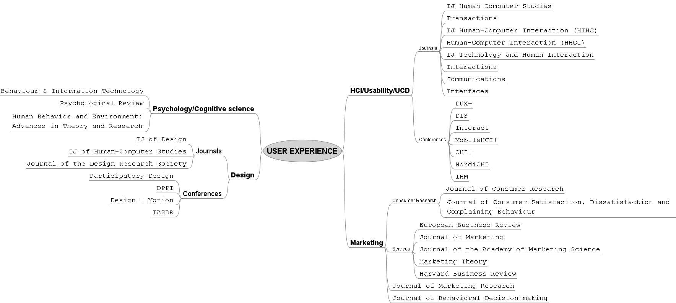
Literature
Forums

Slide 15
Literature
UX related topics
Satisfaction
  Fulfilling/exceeding expectations
Usability
  Efficiency, effectiveness, satisfaction – Quality of use
  Mental demand
Pleasure, Trust, Engagement, Fun, Flow
  Social-, ideological-, psychological-, physiological pleasures
  Extending usability to enjoyment
Delight
  Surprising the consumer
Emotions/Affect
  Visceral, behavioral, reflective responses towards IT
Technology Acceptance
  Usefulness, ease of use -> attitude towards IT
Value/worth
  Means-end chain (knowledge of self/product knowledge)
  Ethics

Slide 16
Literature
Usability
Pros:
  Extensively studied, good methodologies
  Every phase in PD can be assessed
Cons:
  Centered mostly on hygiene factors
  Satisfaction is absence of frustration

Slide 17
Literature
Towards pleasure…
Pros
  Potentially fertile grounds ☺
Cons
  Objectivity or inter-subjectivity of findings is problematic
  Only few operationalizations

Slide 18
Literature
Service Marketing/Management
Pros:
  Long history, lots of examples
Cons:
  Emotional aspects mostly excluded
  Results dependent on customization

Slide 19
Literature
Behavioural Studies
Pros:
  Deep understanding of humans
Cons:
  Methods are not easily transferable to practicioners
  No discount methods

Slide 20
Literature
Value / Worth
Pros:
  A multi-faceted view on users
  Taking into account practices
Cons:
  Methods are scarce and untested
  Focusing on the cognitive

Slide 21
Literature
Emotions/Affect
Pros:
  Objective and subjective assessment
Cons:
  Identifying underlying reasons

Slide 22
Literature
UX Measurements
Pros:
  This is what we are trying to do ☺
Cons:
  Methods haven’t been tested exhaustively, methods are limited
  Not defined

Slide 23
Literature
Measurable items…
User Value
(Holbrook 1999)
Efficiency
Excellence
Play
Aesthetics
Status
Esteem
Ethics
Spirituality
Boztepe (2007)
utility
social significance
Emotional
spiritual
UX metrics
(Hassenzahl et al 2003)
Pragmatic Quality
Hedonic Quality
  Stimulation
  Identification
(Laugwitz et al 2008)
Attractivity
Perspicuity (clarity/comprehensibility)
Efficiency
Dependability
Stimulation
Novelty

Slide 24
Literature
Measurable items…
User Satisfaction
(Kirakowski 1996)
Efficiency
Affect
Helpfulness
Control
Learnability
NASA TLX
(Hart & Staveland 1988)
Mental demand
Physical demand
Temporal demand
Performance
Effort
Frustration

Slide 25
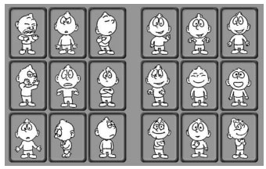
Literature
Measurable items…
ServQual/ServPerf
(Parasuraman et al 1988)
Tangibles
Reliability
Responsiveness
Assurance
Empathy
PrEmo
(Desmet 2003)

Slide 26
Status of the project
Interviews
Literature
Project Plan

Slide 27
Project Plan
Milestone 2
Background study and preliminary framework of UX
 | 1 | 1 | 2 | 2 | 3 | 3 | 4 | 4 | 5 | 5 | 6 | 6 | 7 | 7 | 8 | 8 | 9 | 9 | 10 | 10 | 11 | 11
UX Framework 1-4
UX Framework 5
UX Integration
UXP 1 & 2
UXP 3 & 4
UXM 1-3
UXM 4-5
UXX

Slide 28
Integrating UXP, UXM and UXX
Interplay & Integration

Slide 29
UX Tools Interplay
All stages: key properties of product category. This is something easy for Nokia.
All stages: relevant user practices. This is something more novel and infinitely more challenging.
UXP: abstract UX goals. Produced by UXP.
UXM: UX properties of the product for concepting. Produced before and evaluated by UXM.
UXX: precise UX properties of the product. Produced before and tested by UXX.

Slide 30
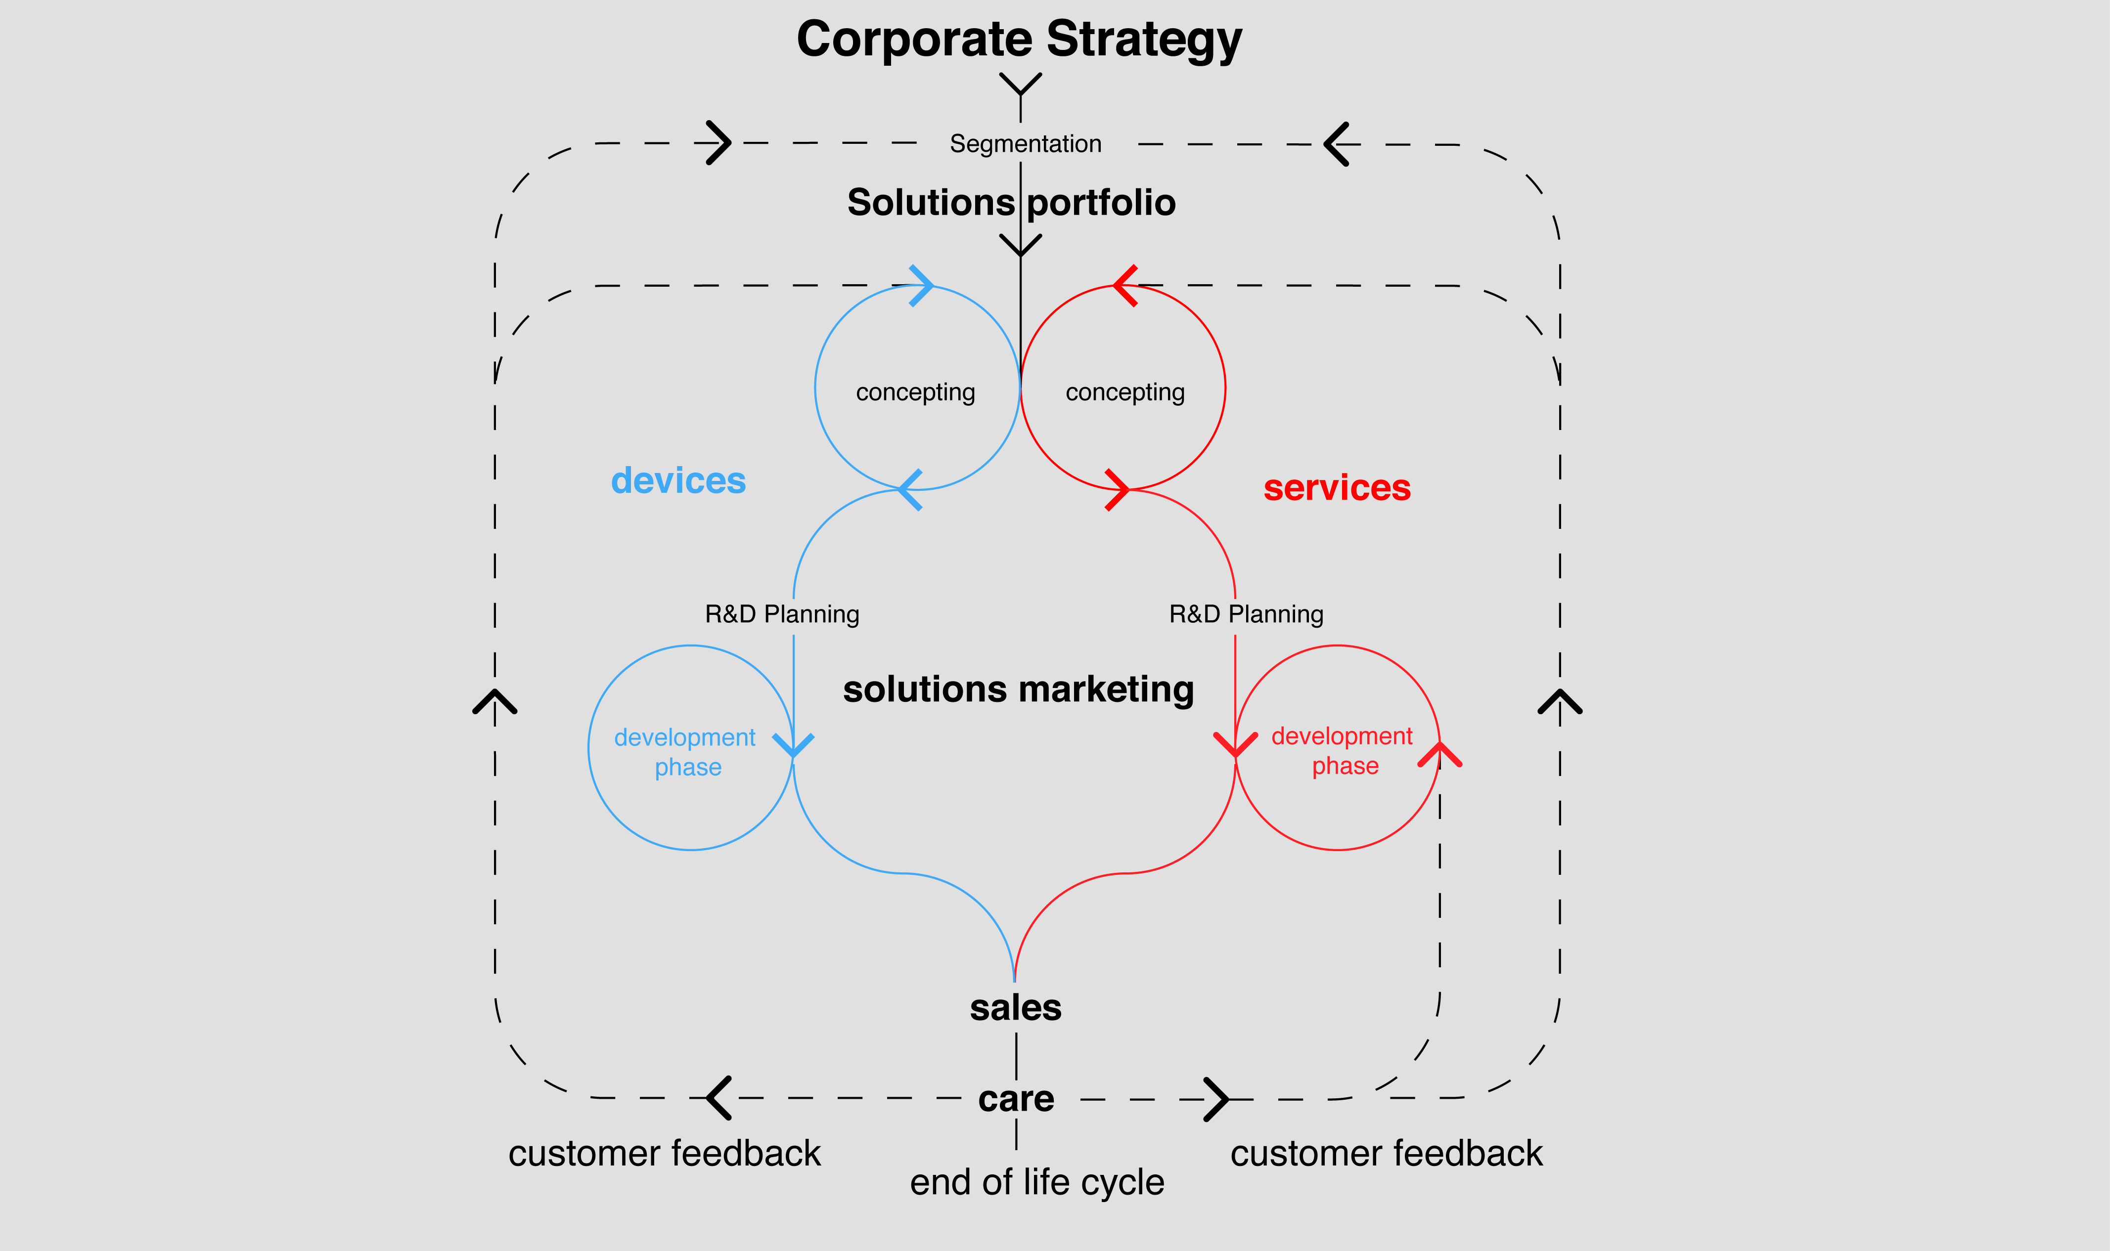
UX Tools Integration?

Slide 31
Focusing UX and Framework
Towards a Framework

Slide 32
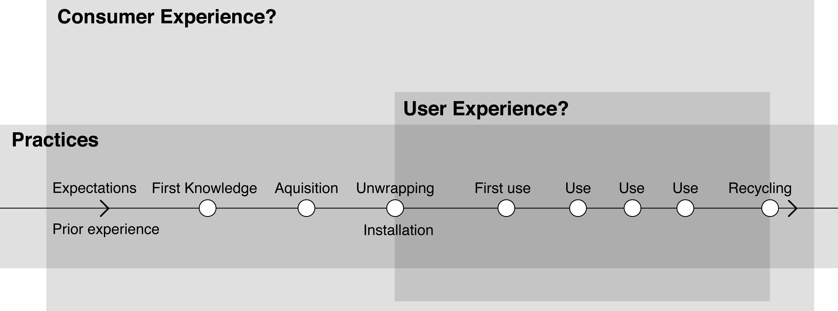
Focusing UX

Slide 33
Focusing UX
Consumer experience
Operationalizations
Product development

Slide 34
UX Framework…

