Slide 1
UX Madness
Preliminary Concept

Slide 2
What is UXM?
User eXperience Madness (UXM) is a tool for evaluating UX in the early stages of Design.
  UXM is employed for getting the “right design” and the “design right”
UXM informs design teams and contributes to UXX for monitoring a products UX-design in successive PD stages.

Slide 3
What is UXM?
UXM is flexible to accommodate different design questions.
  New functionality for users
    What role should it play in the users lives?
    What features are needed to support it?
  Presenting functionality in a new way
    How the artifact will look and feel

Slide 4
What does UXM do?
UXM evaluates against targets set by UX Profiler
  identifying perceived salient attributes and linking those to personal meaning
  Comparison of results with predefined targets
UXM produces user feedback on evolving design
  Critiquing prototypes on alternate design directions
  Providing suggestions for further development

Slide 5
Prerequisites for UXM
Identification phase for product opportunity completed
Defined preliminary UX targets/criteria
First prototypes available
  Different alternatives
  Level of prototype does not matter
    level of resolution: amount of detail
    level of fidelity: closeness to eventual design
We define a prototype as any representation of a design idea, regardless of the medium.

Slide 6
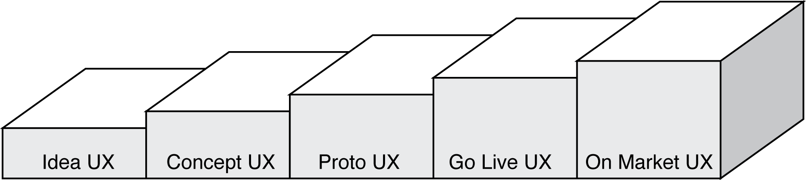
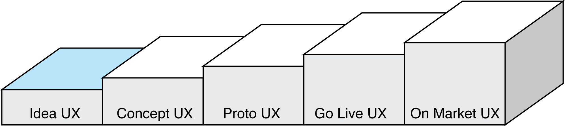
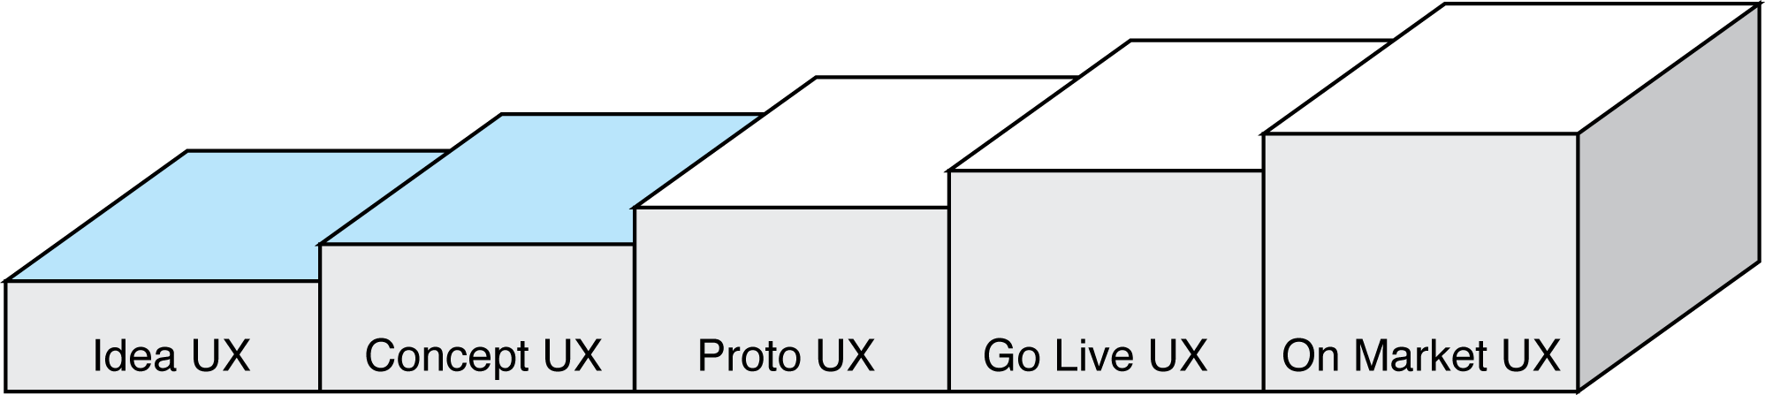
The realm of UXM…
… in the UX Process:
UXM evaluates ideas
  Early prototypes: storyboards, videos, etc…
UXM evaluates concepts
  Simulating solution alternatives: Paper prototypes, Wizard of Oz, Flash prototypes, etc…
Notes:
How to overcome the gaps between idea, concept, implementation…Idea and concepting done by different teams at the moment…UXM stays the same!
Implementation phase – program start: concept is broken in parts which causes loosing the bigger picture

Slide 7
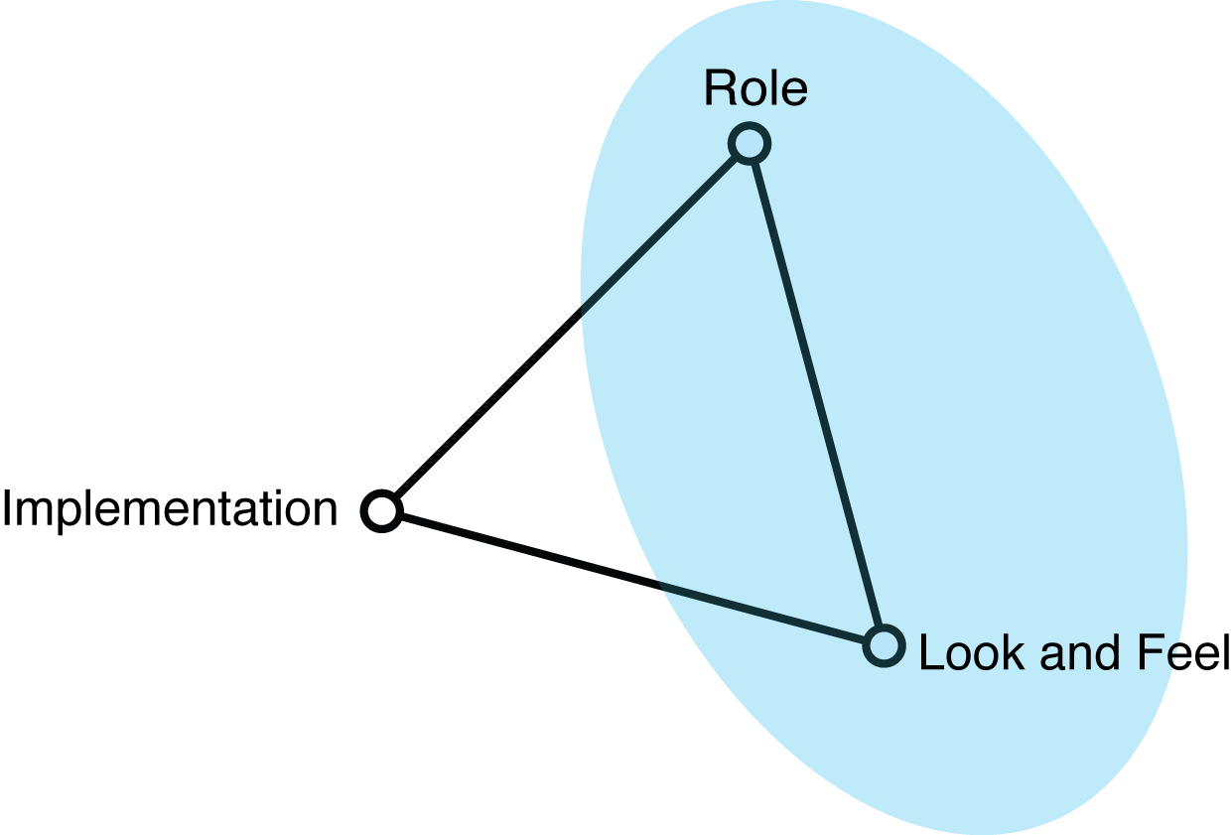
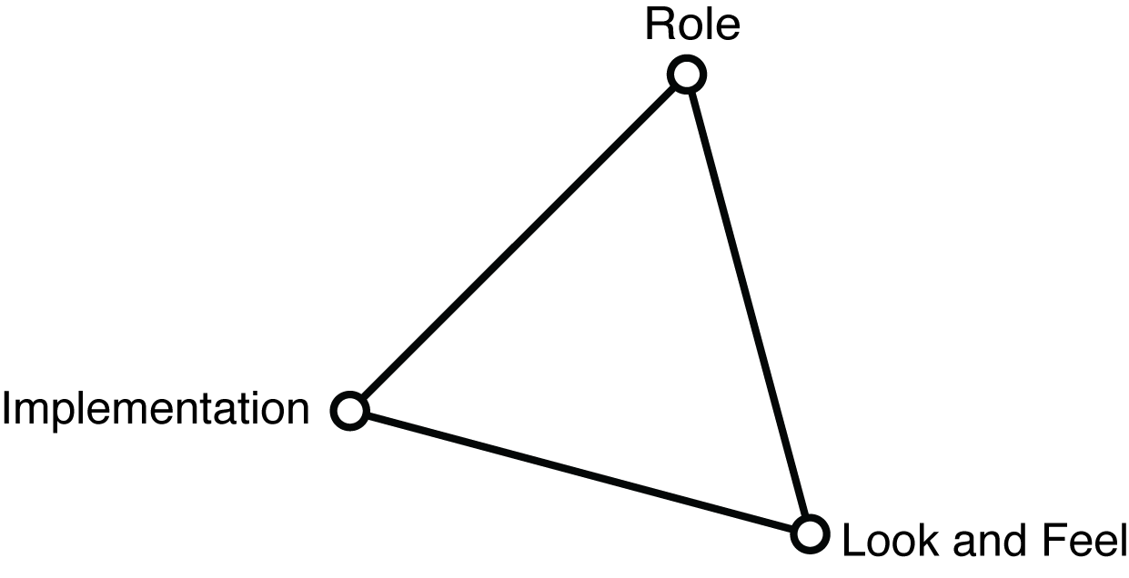
The realm of UXM…
… concerning the solution:
Model adapted from Houd and Hill (1997)
Notes:
“Role” refers to questions about the function that an artifact serves in a user’s life—the way in which it is useful to them.
“Look and feel” denotes questions about the concrete sensory experience of using an arti- fact—what the user looks at, feels and hears while using it.
“Implementation” refers to questions about the techniques and components through which an artifact performs its function—the “nuts and bolts” of how it actually works.

Slide 8
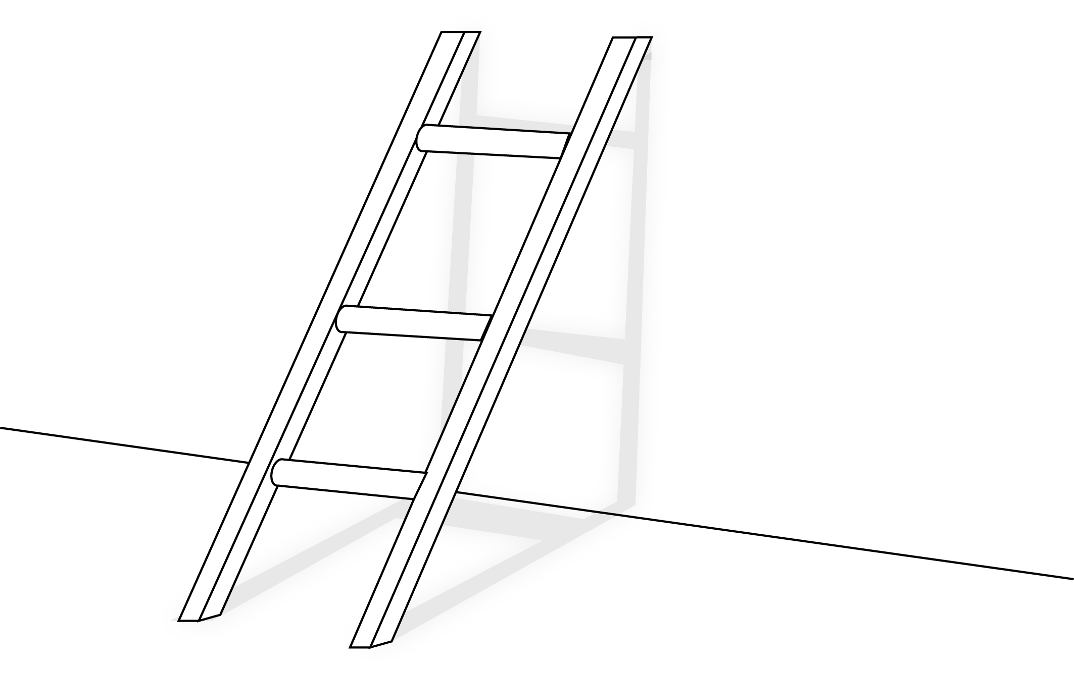
Eliciting personal meaning
Be goals / motives
Why?
Being close to s.o.
Do goals / action
How?
Making a phone call
Motor goals / operation
What?
Click button
Model adapted from Hassenzahl (2010)
Notes:
More interaction oriented
Psychological needs: Autonomy – Independence | Competence – effectance | Relatedness – belongingness | Self actualization – meaning | Security – control | Money – luxury | Physical thriving – bodily | Self-esteem – self respect | Pleasure - Stimulation

Slide 9

Eliciting personal meanings
Terminal value
Quality of life
Instrumental value
Self knowledge
Own health
Psycho-socio consequence
Makes me feel good
Functional consequence
Eating healthy
Abstract attributes
Product knowledge
Fat free
Concrete attributes
Salad
Model adapted from Gutman (1982)
Notes:
: meanings derived of whatever product attribute – understanding the links between formal product properties, experiential product properties, product benefits and characteristics of the person
Other example: possible ladder from a feature of a stereo system:
Investigator: Please tell me something that you do/don’t like about this product:
- Black colour -> same colour as other stereos -> Having the same colour as others is boring -> expressing own tastes is important -> expressing individuality is important…

Slide 10
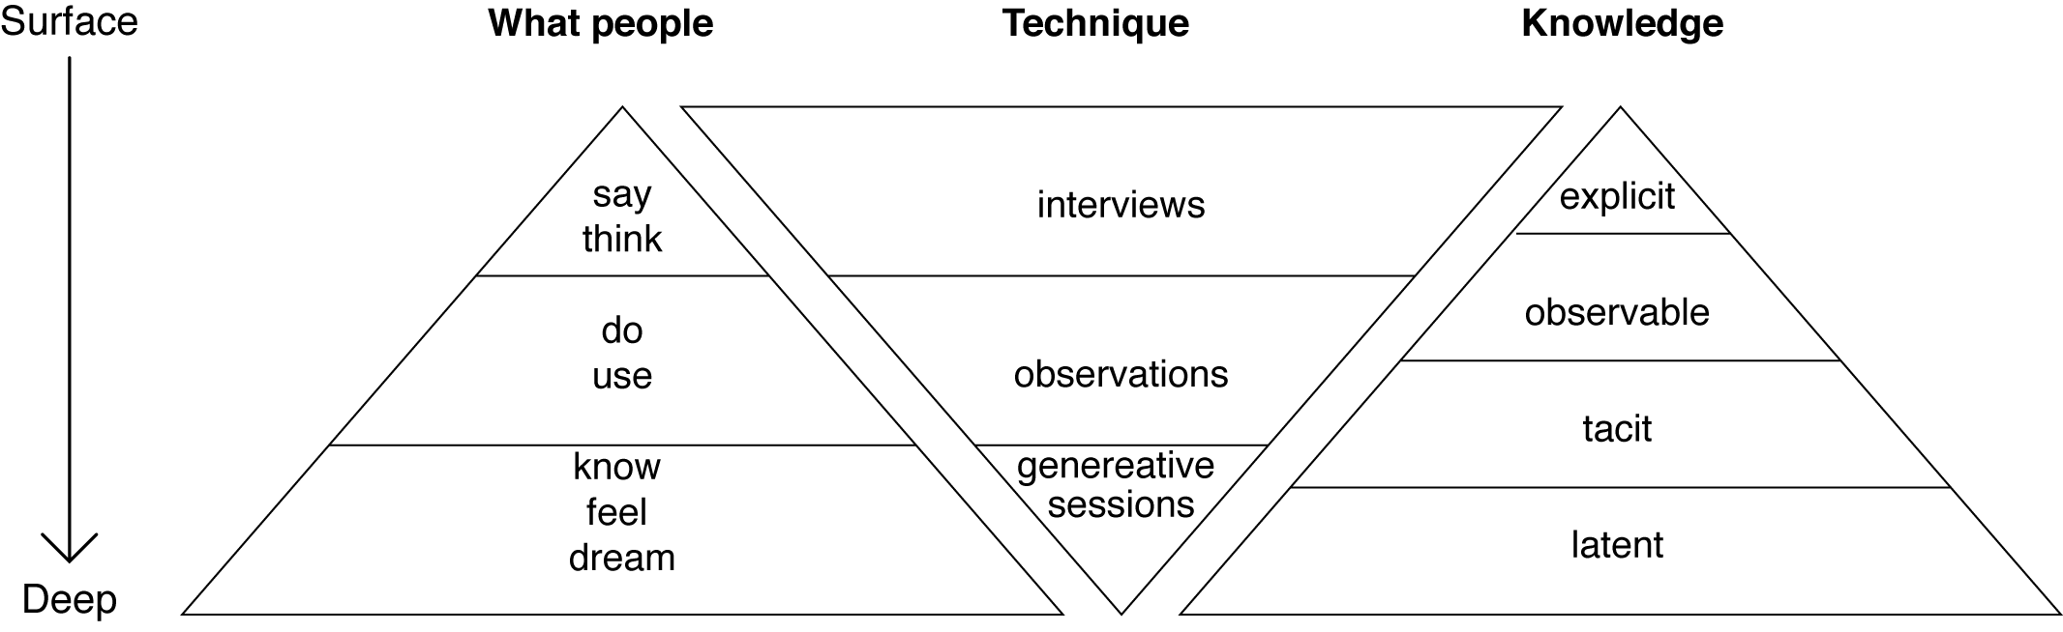
Accessing Knowledge
Sleeswick et al. 2005

Slide 11
UXM Process
Generating
Laddering
Positive and negative attributes
Post-use questionnaire
Interaction
Pre-use questionnaire
Notes:
Users previous experiences
Aim: to gather information about users’ prior experiences, expectations, and expertise concerning the product-to-be-tested (to serve later analysis of the moderating effects of these on UX“Interaction” with prototypes
Selection of task/scenario (relevance of KSP)
2. Executing task and thinking aloud
Simple post-use questionnaire
Attribute elicitation
Direct elicitation
Laddering meanings
Associations elicitation (images)
Sketching/acting ideal

Slide 12
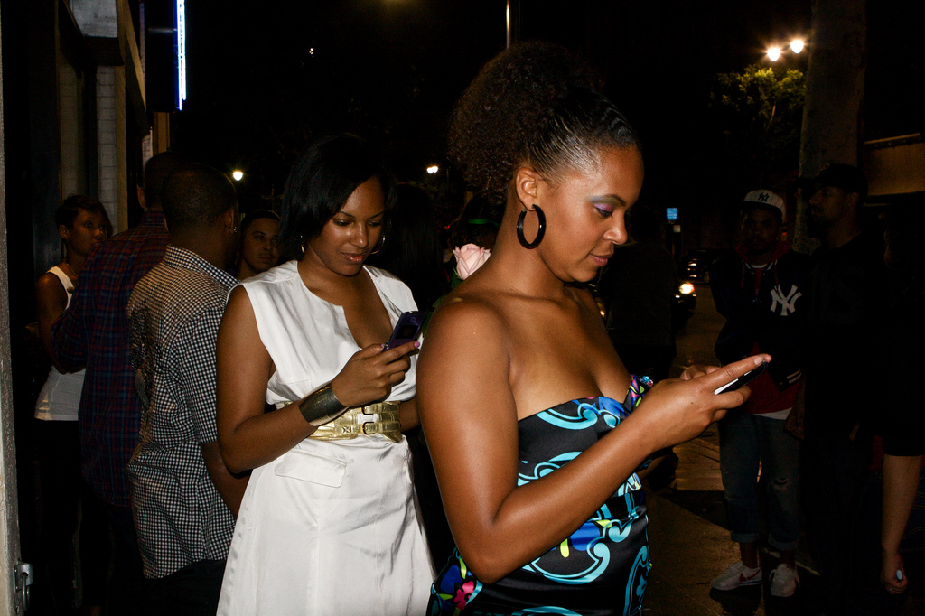





UXM Tools 1
“UXM Associator”
  selection of x images
  experiential aspects (positive-negative) based on Hassenzahl’s hedonic quality items as starting reference for creation…
Notes:
Disadvantages of laddering: time consuming, and not remotely done. Demanding for participants: feeling pressured to justify their statements with rational explanations.
vMood board: isual tool to quickly inform others of the overall 'feel' (or 'flow') that a designer is trying to achieve

Slide 13
UXM Tool 2
UXM Generator

Slide 14
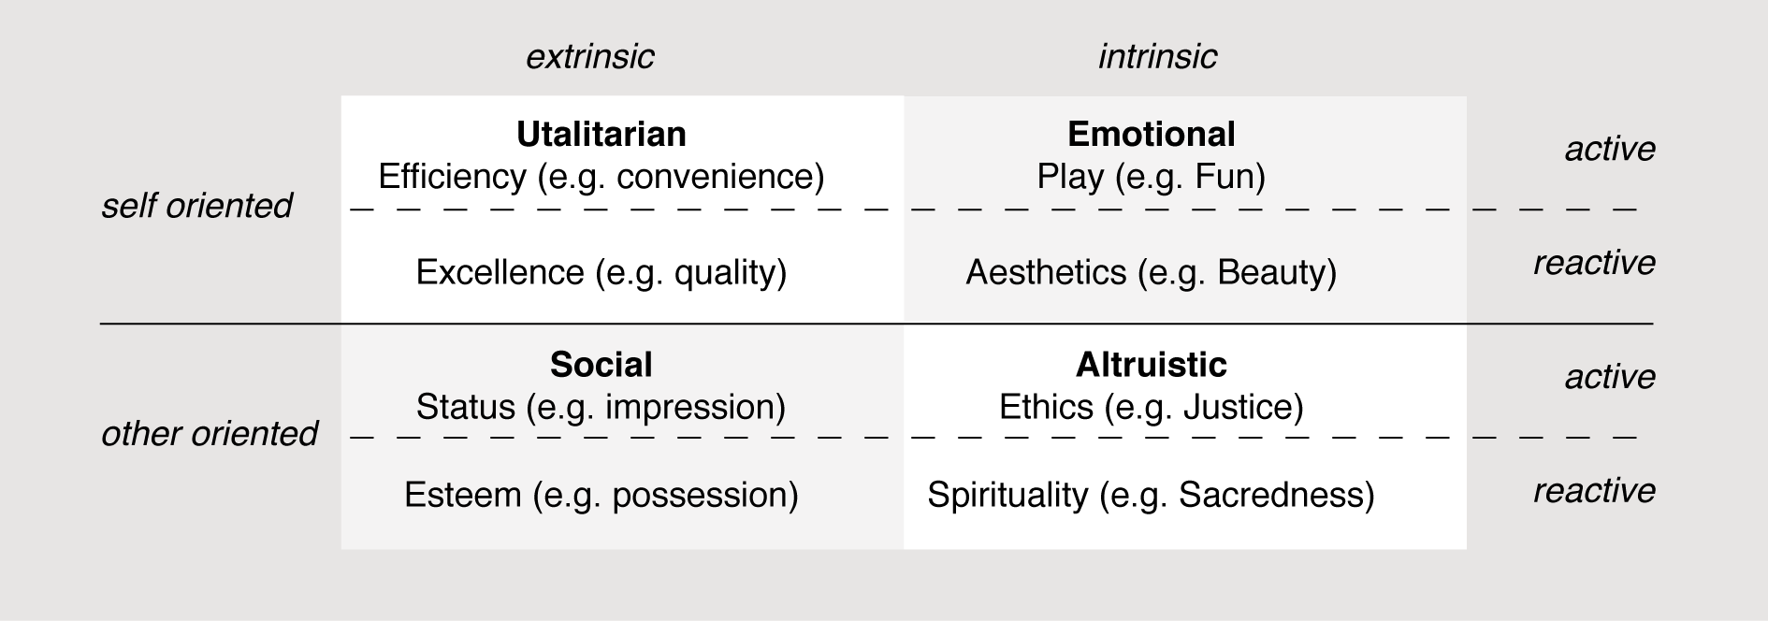
Framework for analysis…
…could be similar to this?
Boztepe (2007) adapted from Holbrook (1999)
Notes:
Intrinsic/extrinsic value determine whether a product is valued as an end per se, or instrumental to help users accomplish certain ends.
The self-oriented/other-oriented dimension reflects the benefits the user obtains from its use itself or due to the responses it draws from others.
Active/reactive corresponds to whether there is a manipulation by the user or vice versa

