Slide 1
UX Framework Description
Review version

Slide 2
UX Framework
The UX framework represents different aspects of user experience within a product development environment, from intended value delivery to actual product use in a specific context. Current tools and methods applied for defining and evaluating interactive products can be mapped and their relations specified.
We try to establish the interconnections between the strategy-, studio- and life ladder. The strategy ladder represents the company's point of view, from strategy to real-life manifestations, i.e. products. The studio ladder displays means to define and explore user experience aspects at different stages of a development process. The life-ladder takes the view of the user starting from motivation to real life interactions with a product. The ladders are constructed in a hierarchical order and they depict the different aspects a company should understand in order to serve the needs that emerge from potential users.
NB: Different boxes and relations do not necessarily agree with standing definitions but are modified to serve the needs of UX design.

Slide 3
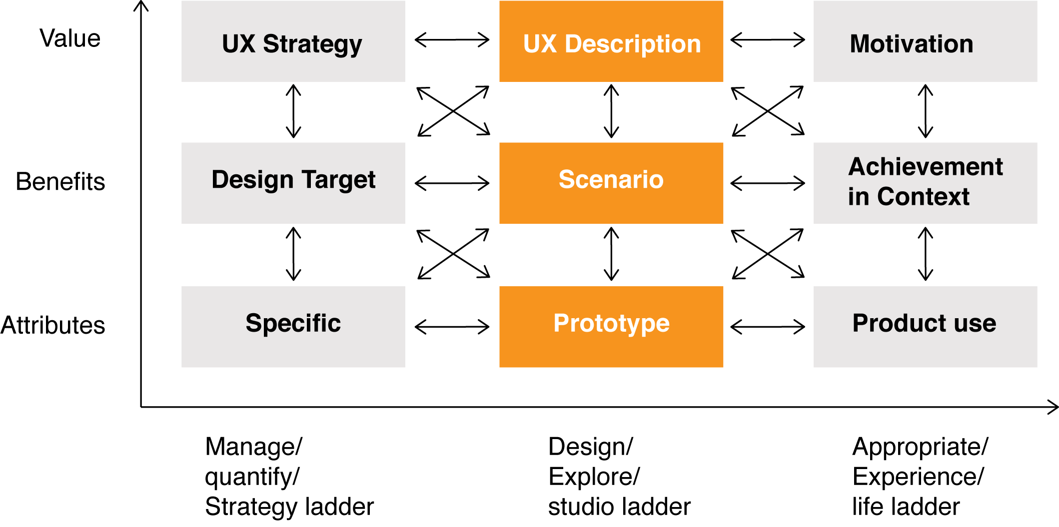
UX Framework

Slide 4
UX Strategy
UX Strategy is the experiential proposition/offering the company intends to deliver to its users
UX strategy represents how the company positions itself in the market. What are the experiential factors that differentiates the companies offering from its competitors.
Relation to UX description: Translation of overlying strategic UX goals into product specific UX descriptions. These descriptions are to support long term motivations for product usage and promote the company in the eyes of the user.
Relation to Scenario: How the company envisions the user achieving desirable ends with the means offered by the company, i.e. how the product fits the user's context.
Relation to Design target: The means to meet the needs/desires of the customers.
The intersection of UX strategy and design targets defines on a product level what the company tries to accomplish with its offering. This offering has to reflect the overall strategic UX goals.

Slide 5
UX Description
UX Description is the vehicle for capturing the intended, designed user experience:
It is a description of a scripted experience while being aware of the wide range of other experiences that naturally emerge when a product is appropriated and used by the user. As a starting point the UX description captures the feeling and the intended meaning the product is going to have for the user. In practical terms this can involve a combination of experience narratives with pictorial associations, sound, textures, shapes, video snippets, etc. The UX Description is trying to be as specific as possible by defining the experiential theme. UX Description should not be used as an alternative to a product concept but as an augmentation for the concepting process.
Relation to Motivation: Depiction of the desired user experience that motivates the user to take action. These desired user experiences are to support action/use on a longer term (e.g. surprise/WOW as motivation is excluded).
Relation to Achievement in Context: describes experiences designed for through achieving favorable goals. What instrumental and non-instrumental goals have to be achieved through product use and their relation to higher goals.
Relation to Scenario: The scenario formulates an (instrumental) activity that is a means to an desired end (non-instrumental) captured by the UX description.
Relation to Design Targets: Is the relation between experiential goals to be achieved and the means the company provides. These means need to take into account the attribution of UX to the product.

Slide 6
Motivation
Are the reasons that motivate the user to act:
The term 'Motivation' is chosen here as an overarching concept to capture the phenomenon of user experience in terms of intrinsically motivated product interaction. These motivations are reflected in the utilitarian, emotional, social and ethical value the product has to the user.
Relation to Achievement: is the relation of enabled activities, through product use, that trigger positive user experiences, i.e. relation be-goals - do-goals
Relation to Scenario: Motivation gives reason for activities in a scenario to take place.

Slide 7
Design Target
Design Targets are the set strategic goals that the company wants to achieve through a product. These goals are not limited to product functionalities but also include marketing and branding.
Relation to Scenario: Scenario explicates the intended benefits of specified design targets in a certain use context.
Relation to Prototype: a prototype works as a testbed to evaluate against set goals by the company.
Relation to specifics: design targets are eventually translated by the product development team into a fine-grained division of implementable parts that are needed to achieve set goals. These include technologies as well as the appearance and the behavior of the product.

Slide 8
Scenario
A scenario is a textual/visual representation shared by the company/designers/users how the future users interact with a product/service:
Scenarios set a product into context. They work as a mediator to sequentially illustrate the intended user product interaction in the real world.
Relation to achievement in a context: perceivable benefits by the user in his own domain. Displays a known situation to the user and offering an alternative (beneficial) way of acting. Scenarios in this context are an evaluation tool to verify assumptions and to assess a products/service overall relevance to the user.
Relation to product use: Scenarios illustrate product use in a fictional context whereas product use represents the product used by a real user in context. It is noteworthy that a scenario is supposed to provide one alternative way of product use and therefore being an assumption of (some) appropriation.
Relation to prototype: Gives direction to functionality and behavior of the product. The scenario acts as an mediation tool to communicate the functional and behavioral requirements which are implemented in the prototype to a multidisciplinary audience.
Relation to specifics: Scenario in conjunction with design targets define the functional requirements that are to be carried out with specifics. Scenarios should not work on the detail-level of specifics if there is no special reason to do so.

Slide 9
Achievement in Context
Are the perceived (instrumental and non-instrumental) benefits of the user attributed to the product: Instrumental and non-instrumental benefits are generally speaking successful completed tasks that are achieved through the manipulation (active) or possession (reactive) of the product.
Relation to product use: Capabilities to accomplish (predefined) tasks with the product. It can also include accomplished tasks through unintended (by the producer) product use because of appropriation.
Relation to prototype: Capability to accomplish (predefined) tasks with the prototype. This relation is commonly studied in usability evaluations to determine pragmatic user-product interaction. Dependent also on the fidelity of the prototype, the perceived hedonic product quality can be assessed.

Slide 10
Specifics, Prototype, Product use
Specifics represent the most detailed level of product characteristics: These characteristics concern e.g. the look & feel of a product, the interaction possibilities, material choices, etc.
Relation to Prototype: Translation and iteration of specific ideas into a real artifact. A prototype can be built for a low number of ideas to explore them further or to study multiple ideas combined. A representation of the design to simulate the behavior and or look and feel of the product in development.
____________________________________________________________________________________
Prototypes are a representation of the design to simulate the behavior and or look and feel of the product in development. Prototypes are, in addition to being solution generation and evaluation tools, also vehicles for team collaboration.
Relation to product: On the highest level of fidelity, a prototype is the attempt to simulate the final design, aesthetics, materials and functionality of the intended design.
____________________________________________________________________________________
Product use describes the moment when the product is fully developed and released.
The user experience can be studied in full only after it has been taken into use and it has had an impact on the life of the users.

